Slide 1
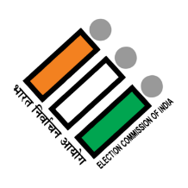
Lok Sabha Election
2014 & 2019
Presented By :- RANA BASAK

Slide 2
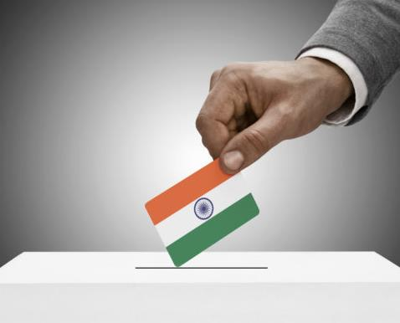
Introduction
The Lok Sabha elections, held every five years in INDIA, is a significant event where citizens vote to elect representatives to the lower house of parliament. This election decide the makeup of the 543- member Lok Sabha, which is essential for shaping the country’s laws and forming the government.
Key Points
A party needs at least 272 seats out of 543 seats to form a government
If no party achieves a majority, parties may form coalitions to create a government.
In case no clear majority is achieved, the president of INDIA may invite the largest party or coalition to prove its majority in the parliament house.
The party or coalition with a majority forms the government, with the leader becoming the Prime Minister.

Slide 3
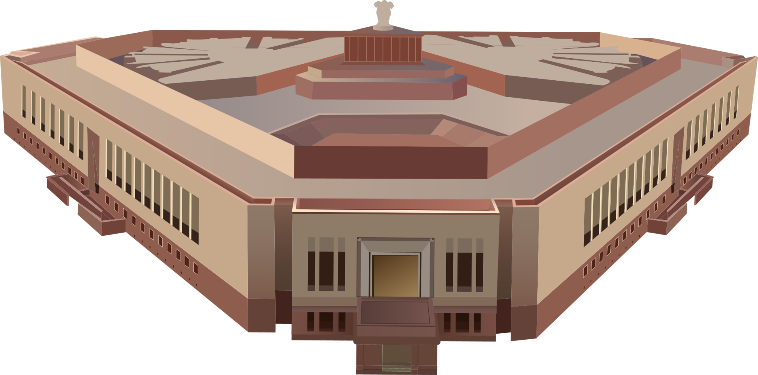
PROJECT OVERVIEW
OBJECTIVES: Conduct a comprehensive analysis of the datasets of 2014 and 2019 Lok Sabha election result
FOCUS: Analyze constituency wise results.
DATASETS: Include detailed information on candidate, vote received and party affiliation, providing valuable insights for the electoral study

Slide 4
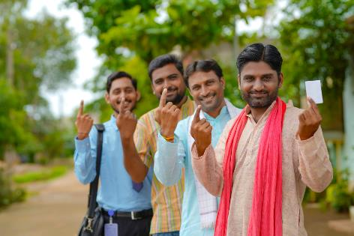
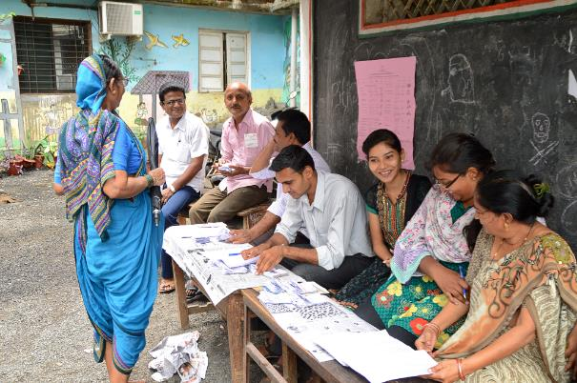
Lok Sabha Election
PRIMARY QUESTIONS

Slide 5
Parliament Of India Structure
Parliament Of India Structure
The
President
Council Of States
(Rajya Sabha)
House Of People
(Lok Sabha)
Not More Than 250 Members
Not More Than 545 Members
12 Nominated By President
Not More Than 238 Representatives Of States & UTS
Not More Than 530 Members Elected By People & 2 Nominated By
Anglo-indian Representative
Not More Than
13 From UTs

Slide 6
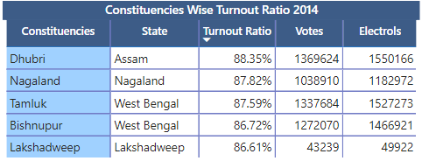
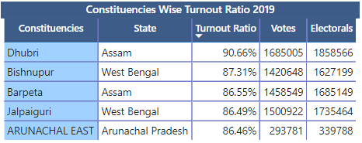
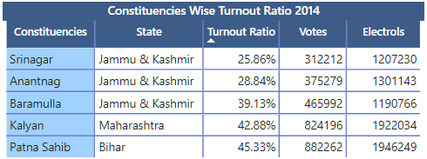
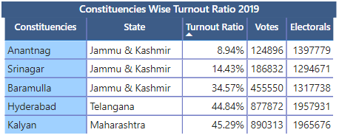
Top/Bottom 5 Constituencies of 2014 & 2019 in term of voter Turnout ratio.
TOP 5 CONSTITUENCIES
BOTTOM 5 CONSTITUENCIES

Slide 7
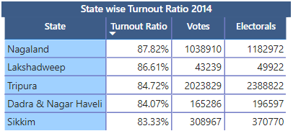
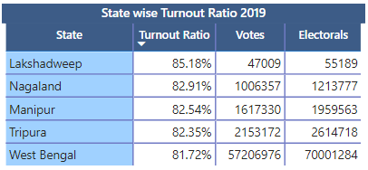
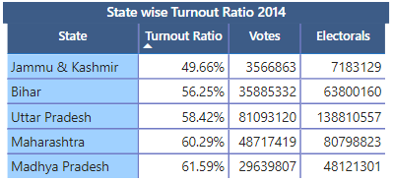
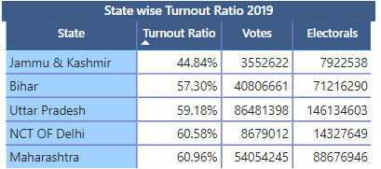
Top/Bottom 5 States of 2014 & 2019 in term of voter Turnout ratio.
TOP 5 STATE
BOTTOM 5 STATE

Slide 8
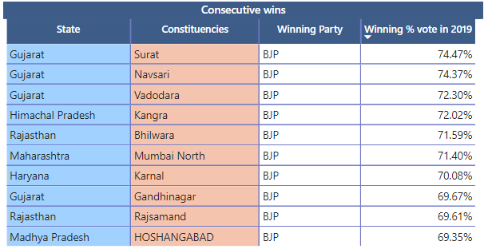
Which Constituencies have elected the same party for two consecutive elections, rank them by % of votes to that winning party in 2019

Slide 9
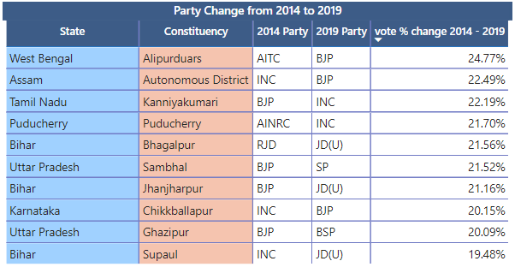
Which Constituencies have voted different parties for two elections (list top 10 based on difference (2019 - 2014) in winner vote percentage in two elections)

Slide 10
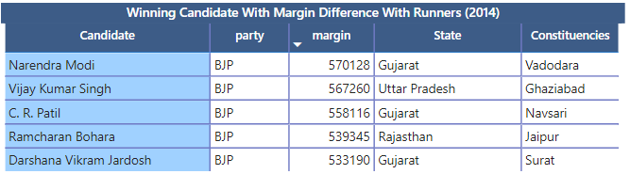
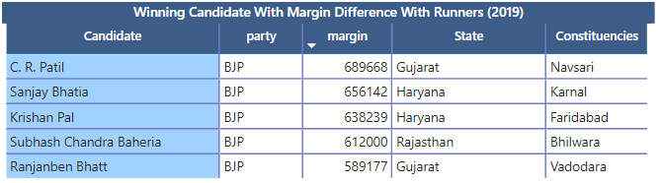
Top 5 candidates based on margin difference with runners in 2014 and 2019.

Slide 11
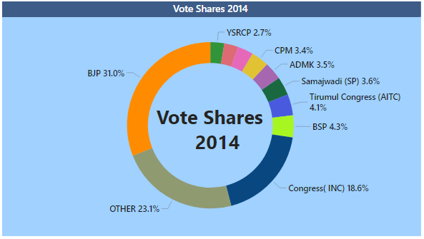
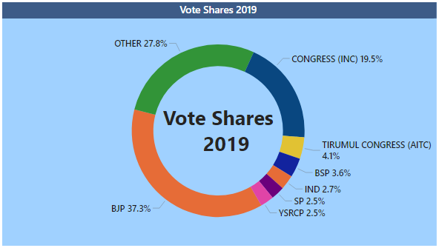
Top 5 candidates based on margin difference with runners in 2014 and 2019.

Slide 12
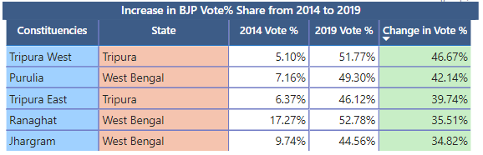
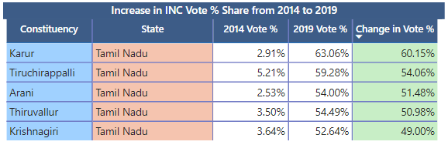
List top 5 constituencies for two major national parties where they have gained vote share in 2019 as compared to 2014

Slide 13
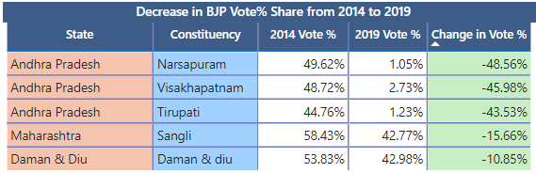
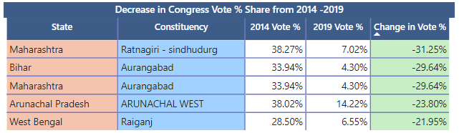
List top 5 constituencies for two major national parties where they have lost vote share in 2019 as compared to 2014

Slide 14
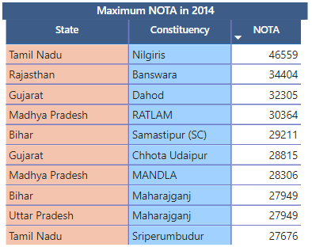
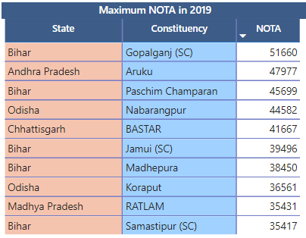
Which Constituency has voted the most for NOTA

Slide 15
Lok Sabha Election
DASHBOARD

Slide 16
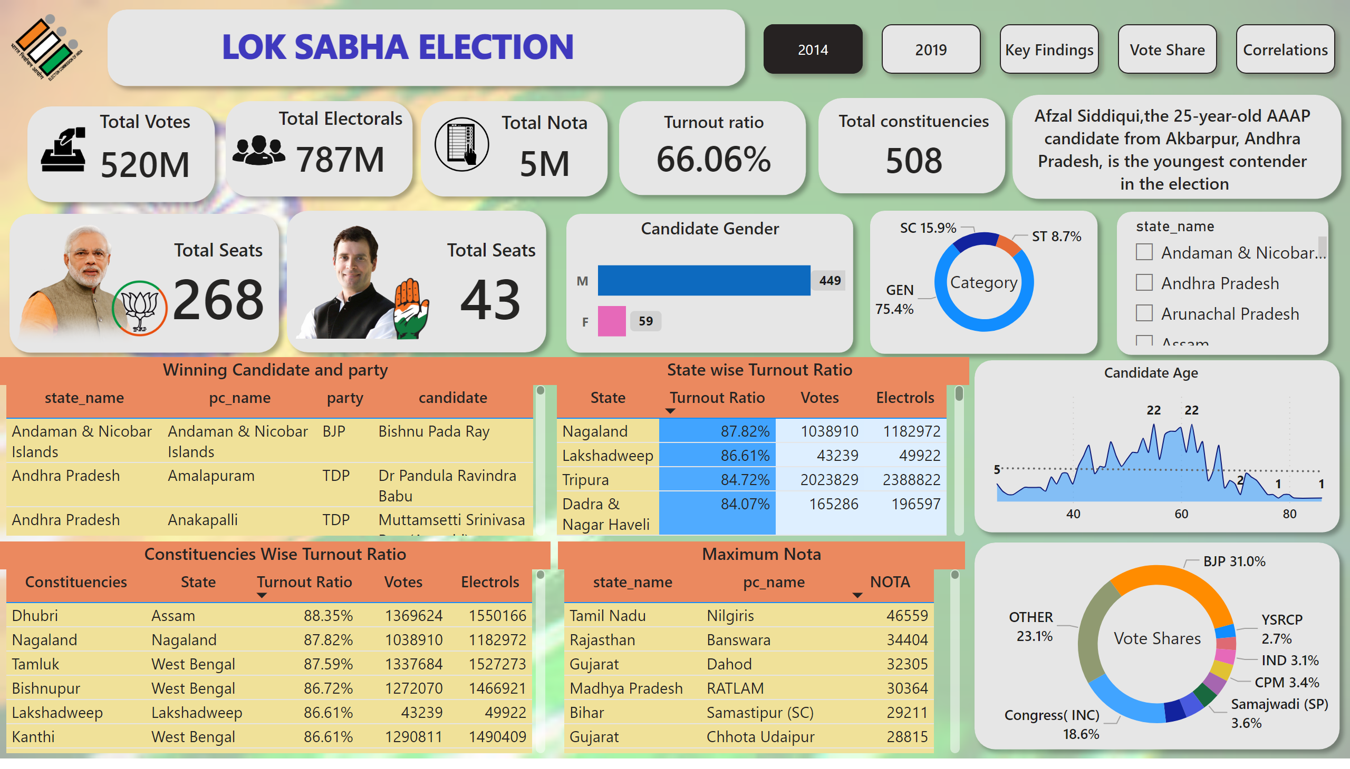
2014
Notes:
shape
No alt text provided
textbox
No alt text provided
image
No alt text provided
shape
No alt text provided
Total Votes
No alt text provided
Total Electorals
No alt text provided
shape
No alt text provided
Total Nota
No alt text provided
shape
No alt text provided
Total constituencies
No alt text provided
shape
No alt text provided
Turnout ratio
No alt text provided
Vote Shares
No alt text provided
shape
No alt text provided
Total Seats
No alt text provided
shape
No alt text provided
Total Seats
No alt text provided
donutChart
No alt text provided
Candidate Age
No alt text provided
Candidate Gender
No alt text provided
State wise Turnout Ratio
No alt text provided
card
No alt text provided
slicer
No alt text provided
image
No alt text provided
shape
No alt text provided
image
No alt text provided
image
No alt text provided
image
No alt text provided
image
No alt text provided
image
No alt text provided
image
No alt text provided
shape
No alt text provided
shape
No alt text provided
shape
No alt text provided
shape
No alt text provided
shape
No alt text provided
shape
No alt text provided
textbox
No alt text provided
textbox
No alt text provided
Constituencies Wise Turnout Ratio
No alt text provided
Maximum Nota
No alt text provided
Winning Candidate and party
No alt text provided
pageNavigator
No alt text provided

Slide 17
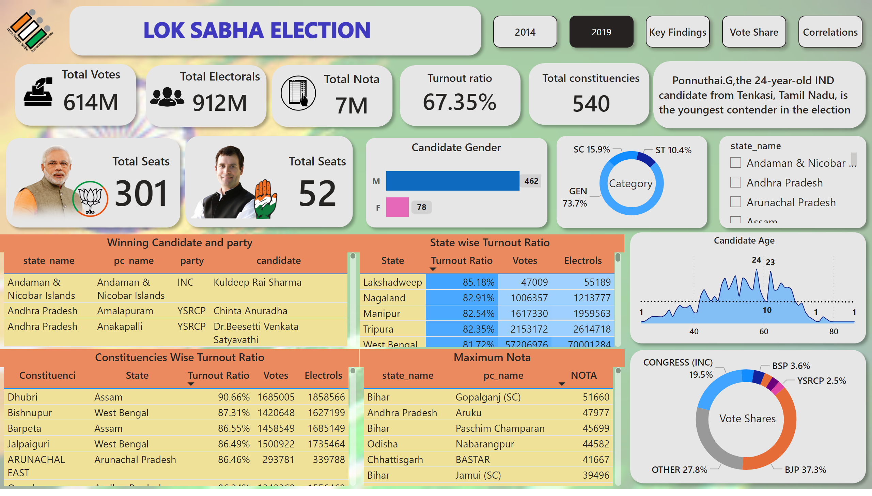
2019
Notes:
image
No alt text provided
textbox
No alt text provided
shape
No alt text provided
Total Votes
No alt text provided
image
No alt text provided
shape
No alt text provided
Total Electorals
No alt text provided
image
No alt text provided
shape
No alt text provided
image
No alt text provided
Total Nota
No alt text provided
shape
No alt text provided
Total constituencies
No alt text provided
shape
No alt text provided
Turnout ratio
No alt text provided
shape
No alt text provided
card
No alt text provided
shape
No alt text provided
textbox
No alt text provided
donutChart
No alt text provided
shape
No alt text provided
slicer
No alt text provided
shape
No alt text provided
Candidate Age
No alt text provided
shape
No alt text provided
Vote Shares
No alt text provided
shape
No alt text provided
Candidate Gender
No alt text provided
shape
No alt text provided
Total Seats
No alt text provided
image
No alt text provided
image
No alt text provided
shape
No alt text provided
Total Seats
No alt text provided
image
No alt text provided
Constituencies Wise Turnout Ratio
No alt text provided
shape
No alt text provided
image
No alt text provided
State wise Turnout Ratio
No alt text provided
Maximum Nota
No alt text provided
Winning Candidate and party
No alt text provided
textbox
No alt text provided
pageNavigator
No alt text provided

Slide 18
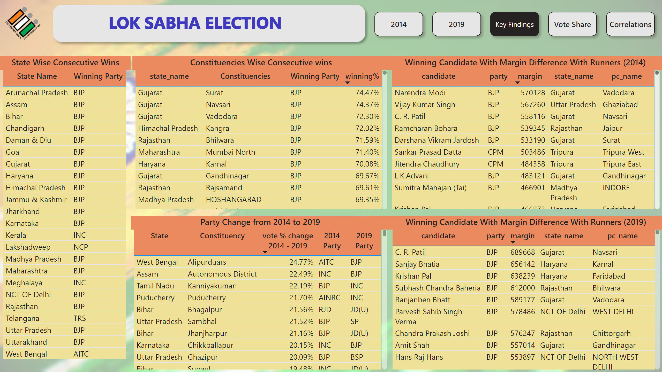
Key Findings
Notes:
image
No alt text provided
textbox
No alt text provided
shape
No alt text provided
Constituencies Wise Consecutive wins
No alt text provided
State Wise Consecutive Wins
No alt text provided
Winning Candidate With Margin Difference With Runners (2014)
No alt text provided
Party Change from 2014 to 2019
No alt text provided
Winning Candidate With Margin Difference With Runners (2014)
No alt text provided
Winning Candidate With Margin Difference With Runners (2019)
No alt text provided
pageNavigator
No alt text provided

Slide 19
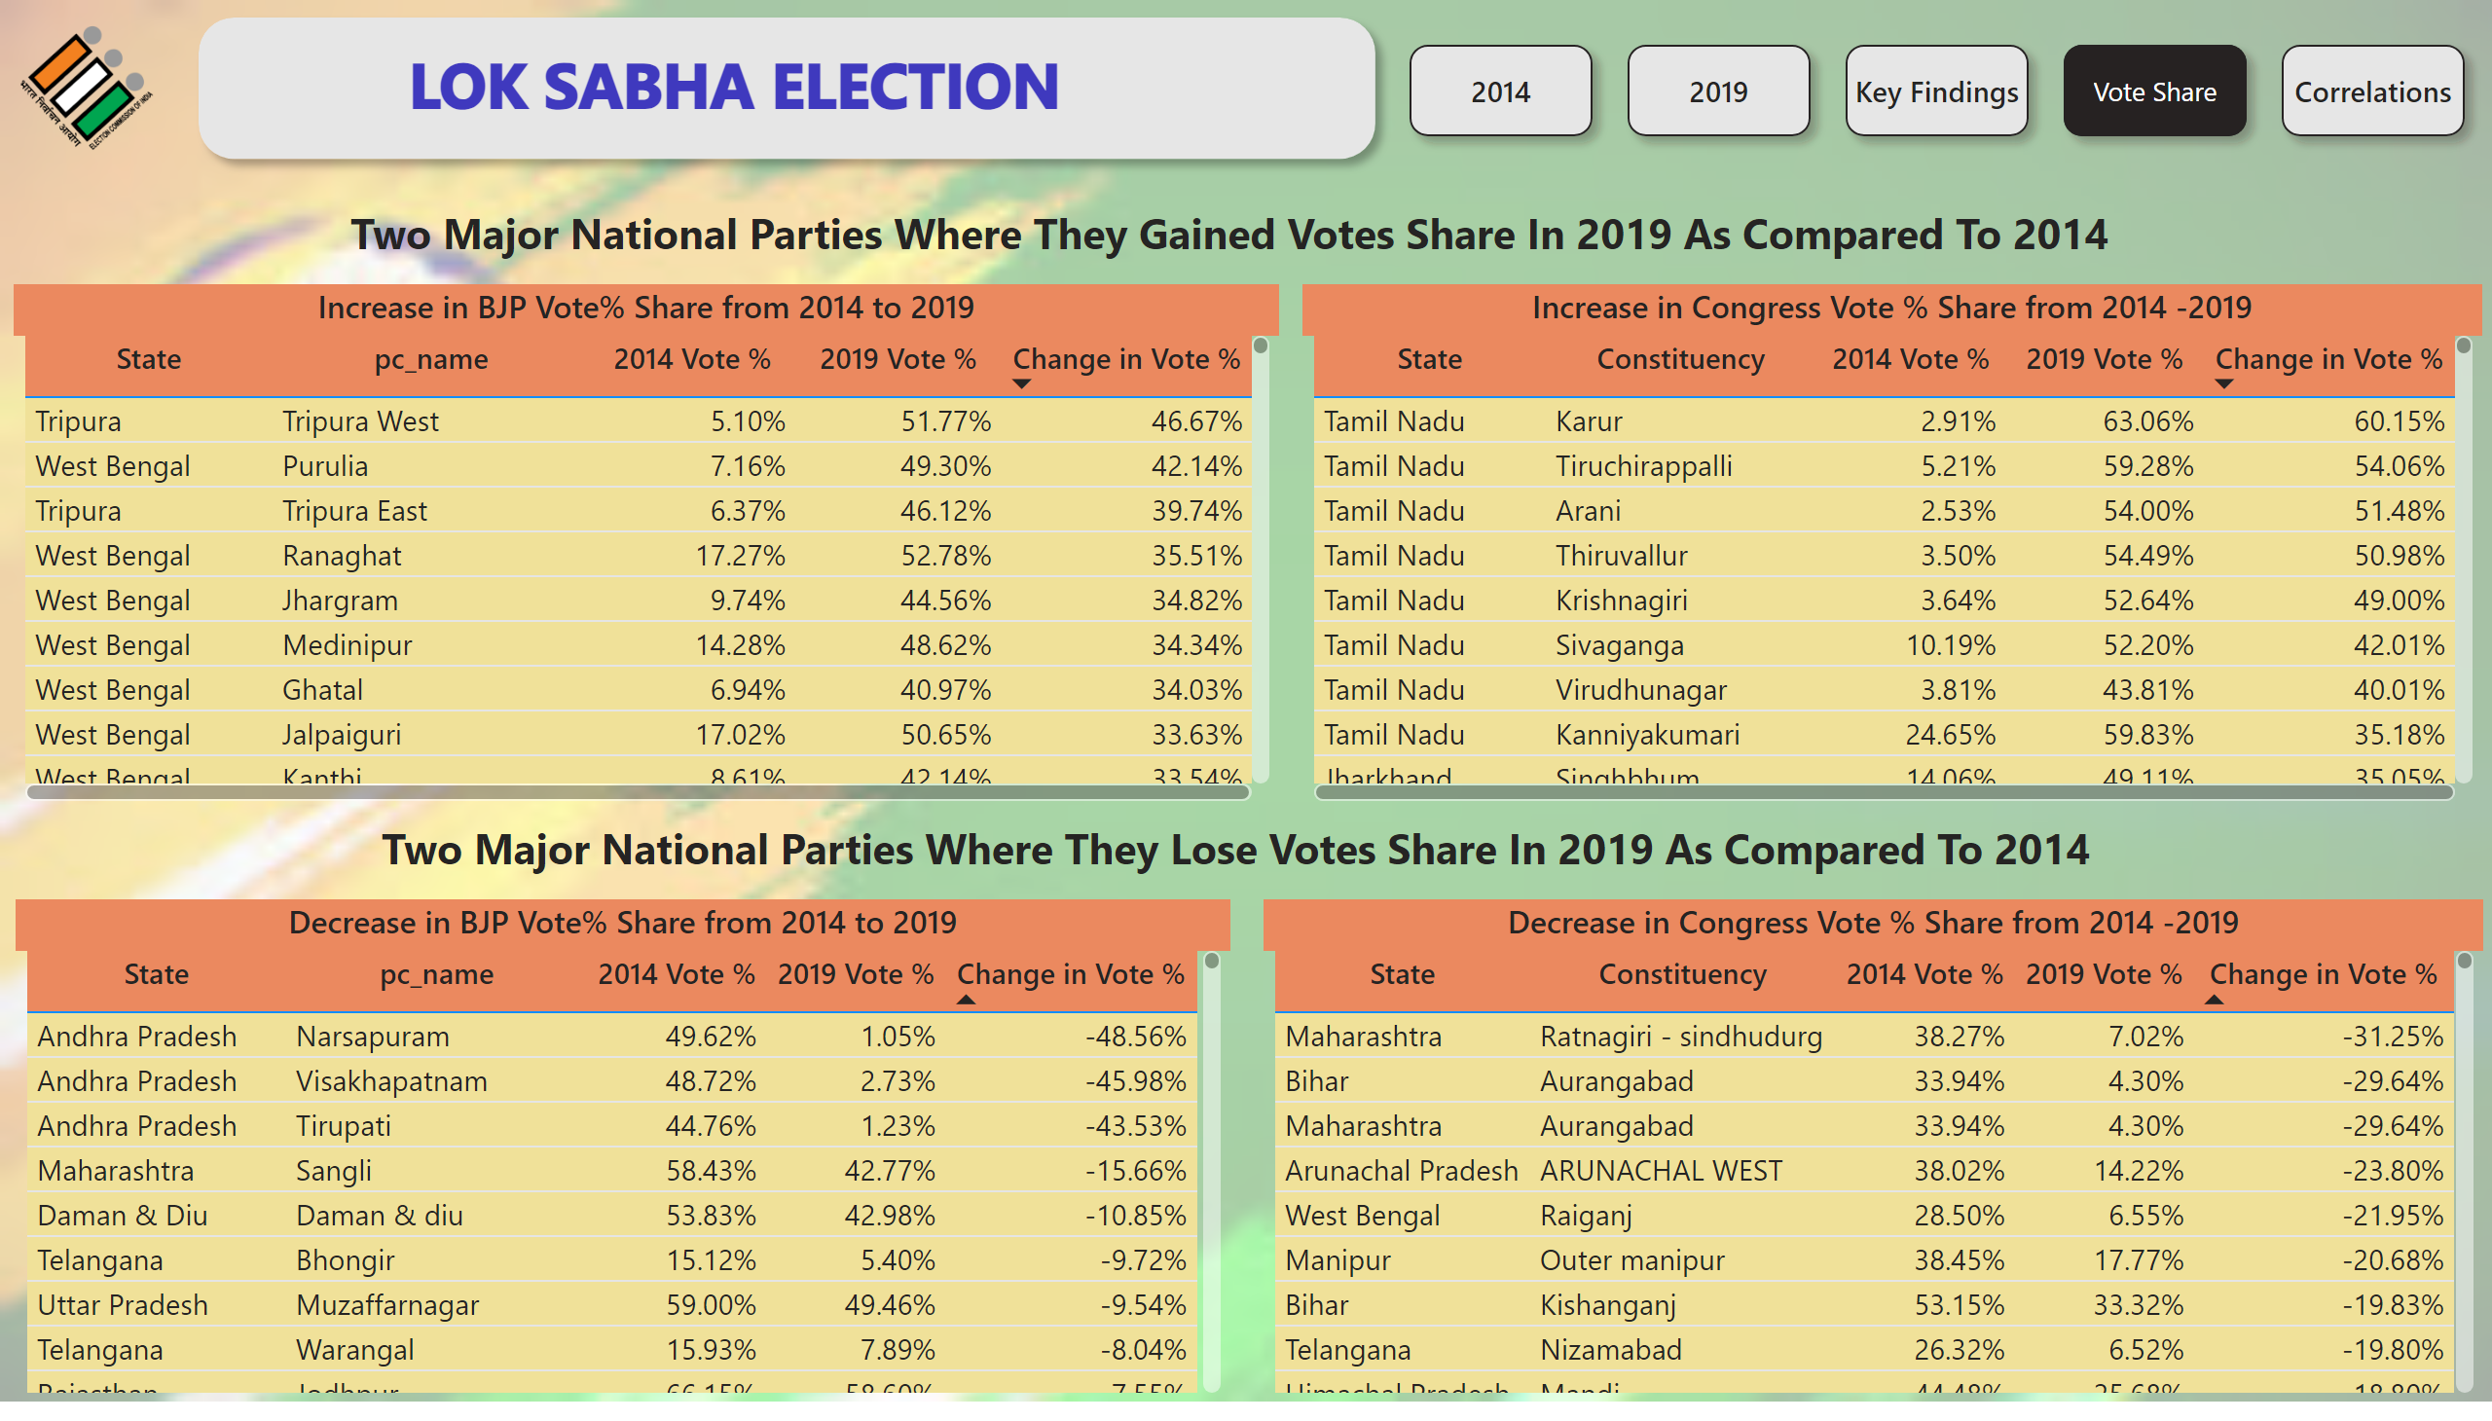
Vote Share
Notes:
image
No alt text provided
textbox
No alt text provided
shape
No alt text provided
Increase in Congress Vote % Share from 2014 -2019
No alt text provided
Increase in BJP Vote% Share from 2014 to 2019
No alt text provided
Decrease in BJP Vote% Share from 2014 to 2019
No alt text provided
Decrease in Congress Vote % Share from 2014 -2019
No alt text provided
textbox
No alt text provided
textbox
No alt text provided
pageNavigator
No alt text provided

Slide 20
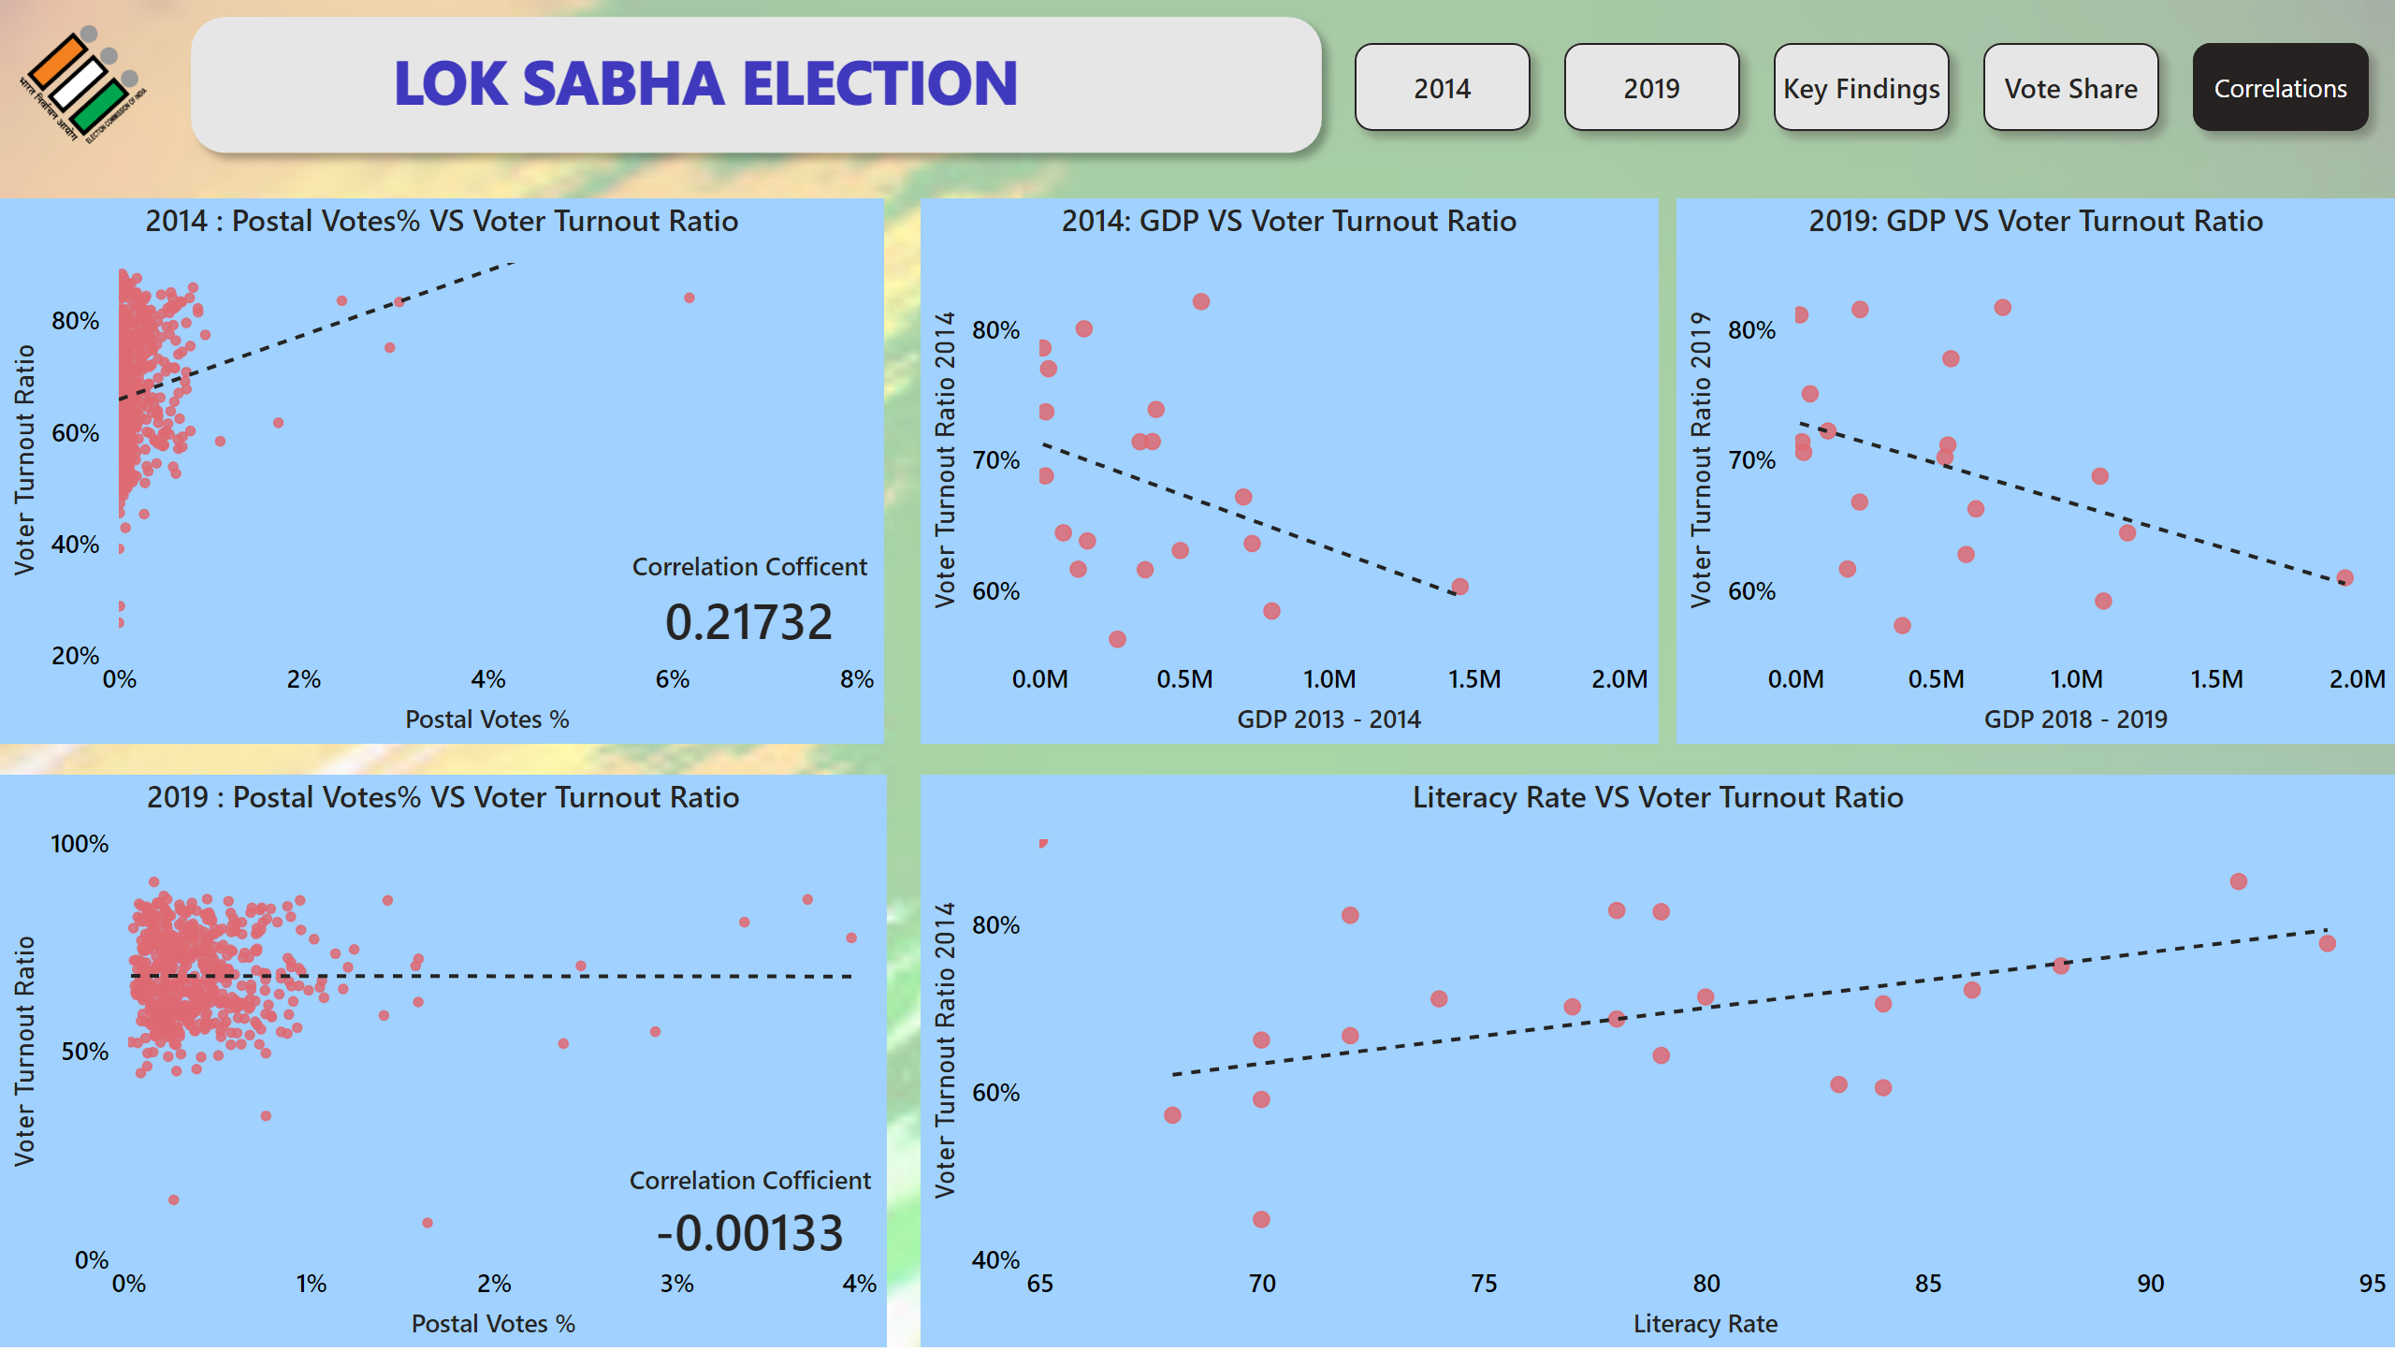
Correlations
Notes:
2014 : Postal Votes% VS Voter Turnout Ratio
No alt text provided
Correlation Cofficent
No alt text provided
2019 : Postal Votes% VS Voter Turnout Ratio
No alt text provided
Correlation Cofficient
No alt text provided
2014: GDP VS Voter Turnout Ratio
No alt text provided
2019: GDP VS Voter Turnout Ratio
No alt text provided
Literacy Rate VS Voter Turnout Ratio
No alt text provided
image
No alt text provided
textbox
No alt text provided
shape
No alt text provided
pageNavigator
No alt text provided

Slide 21
Lok Sabha Election
INSIGHTS & RECOMMENDATIONS

Slide 22
INSIGHTS
Voter Turnout
2014: The voter turnout was approximately 66.06%, the highest ever recorded in the history of Indian general election at that time.
2019: The voter turnout further increased to about 67.35%, showing a continued trend of growing electoral participation.
Gender Participation
2014: Women voter accounted for 65.63% of the total voter turnout.
2019: There was a notable increase in women’s participation, with women voters accounting for 67.18% of the total voter turnout.

Slide 23
INSIGHTS
Youth Participation
2014: A significant portion of the electorate comprised first time voters, with about 23 million new voters aged 18-19.
2019: The number of first time voters increased to 45 million, reflecting the growing political engagement among youth.
Winning Margins
2014: Several constituencies had narrow winning margins, indicating highly competitive elections.
2019: The trend continued with close contests in many constituencies with some saw increased winning margins due to stronger party influences.

Slide 24
INSIGHTS
Party Performance
2014: Bharatiya Janata Party (BJP) won 268 seats, securing a majority on its own. The Indian national congress (INC) faced a significant defeat, winning only 43 seats.
2019: BJP further increased its tally to 301 seats, while INC improved slightly but remained far behind with 52 seats.
Regional Parties
2014: Regional parties like AITC and AIADMK performed well in their respective states.
2019: Regional parties continued to hold sway with AITC, YSR, INC, and DMK making significant gains in West Bengal, Andhra Pradesh and Tamil Nadu.

Slide 25
3 Recommendations on what the election commission/ government can do to increase the voter turnout %
Enhance Voter Registration : Implement automatic and same-day voter registration to make it easier for people to register and vote. This can significantly reduce barriers for potential voters.
Increase Accessibility : Ensure that polling places are accessible to all individuals, including those with disabilities and those who speak different languages. This can include providing transportation options and language assistance.
Launch Awareness Campaigns: Run targeted outreach campaigns that educate voters about the voting process and the importance of their participation. Collaborating with community organizations can help reach underrepresented populations effectively.

Slide 26
Thank You!
We respect your valuable time with my presentation!
Presented by :- Rana Basak

